Slide 1
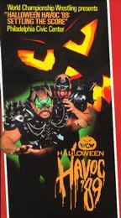
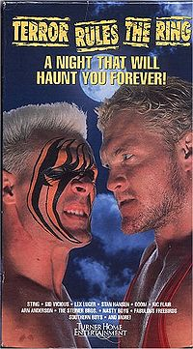
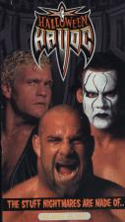
THE HISTORY OF WCW HALLOWEEN HAVOC
THE EVENT MADE
IN
HELL
1989 - 2000

Slide 2
TERROR BEGINS
Halloween Havoc was an annual professional wrestling pay-per-view produced by World Championship Wrestling from 1989 through 2000. The final five events were held in Las Vegas, Nevada at the MGM Grand Garden Arena. World Wrestling Entertainment has owned the rights to Halloween Havoc since they purchased WCW in 2001, however to date, they have not yet produced their own version of the event.

Slide 3
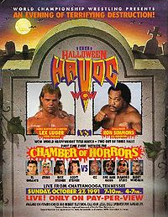
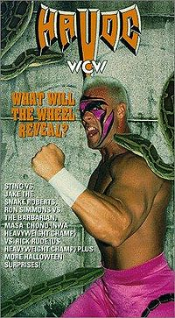
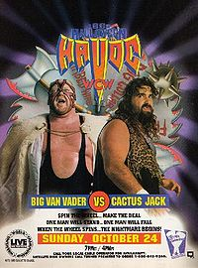
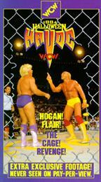

Slide 4
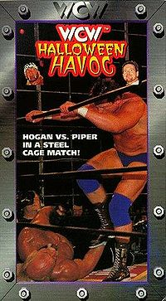
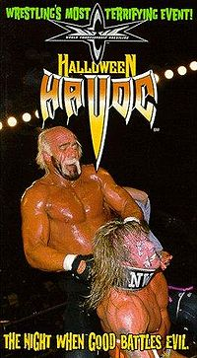
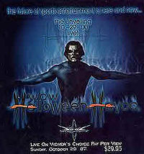

Slide 5
1989
Doom (Ron Simmons and Butch Reed) (with Woman) defeated The Steiner Brothers (Rick and Scott) (15:26)
Reed pinned Rick after a headbutt.
Lex Luger defeated Brian Pillman to retain the NWA United States Championship (16:48)
Luger pinned Pillman after hitting him with the top rope.
The Road Warriors (Hawk and Animal) (with Paul Ellering) defeated The Skyscrapers (Sid Vicious and Dan Spivey) (with Teddy Long) by disqualification (11:39)
Ric Flair and Sting (with Ole Anderson) defeated The Great Muta and Terry Funk (with Gary Hart) (with Bruno Sammartino as special guest referee) in a Thunderdome match (21:55)
Flair and Sting won when Hart threw in the towel for his

Slide 6
1989 intro and luger vs pillman
http://www.youtube.com/watch?v=7lYYsA3225o
http://www.youtube.com/watch?v=jP5w6xfVyAw

Slide 7
1990
The Steiner Brothers (Rick and Scott) defeated The Nasty Boys (Brian Knobbs and Jerry Sags) to retain the NWA United States Tag Team Championship (15:24)
Scott pinned Knobbs.
The Junkyard Dog defeated Moondog Rex (3:15)
JYD pinned Rex.
NWA World Tag Team Champions Doom (Ron Simmons and Butch Reed) fought Ric Flair and Arn Anderson to a double count-out (18:20)
Doom retained the titles.
Stan Hansen defeated Lex Luger to win the NWA United States Championship (9:30)
Hansen pinned Luger.
Sting defeated Sid Vicious to retain the NWA World Heavyweight Championship (12:38)

Slide 8
1990 matches
http://www.youtube.com/watch?v=yaPbVFKb-1A
http://www.youtube.com/watch?v=d4oojEJAYfA
http://www.youtube.com/watch?v=inMHKk87v_g
http://www.youtube.com/watch?v=-qe4qlvtNfg
http://www.youtube.com/watch?v=rK4hOQZ30wc
http://www.youtube.com/watch?v=p8oDoiGo3vA
http://www.youtube.com/watch?v=u0SuxdhY97A
http://www.youtube.com/watch?v=IyaIRt4rjIg
http://www.youtube.com/watch?v=x4zt3h5-oEs
http://www.youtube.com/watch?v=B_A4gVgppRI
http://www.youtube.com/watch?v=dTNDP0Dm3Bk

Slide 9
1991
El Gigante, Sting, and The Steiner Brothers (Rick and Scott) defeated Abdullah the Butcher, The Diamond Studd, Cactus Jack and Big Van Vader in a Chamber of Horrors match (12:33)
WCW World Television Champion Steve Austin fought Dustin Rhodes to a time-limit draw (15:00)
Austin retained the title.
Lex Luger (with Harley Race) defeated Ron Simmons (with Dusty Rhodes) in a two out of three falls match to retain the WCW World Heavyweight Championship

Slide 10
1991 Build up and the chamber of horrors match
http://www.youtube.com/watch?v=KWZxIfwkzbA
http://www.youtube.com/watch?v=iRQz8ec6fY0
http://www.youtube.com/watch?v=rk0as0gpQB8
http://www.youtube.com/watch?v=5v1uXyPC5Sk

Slide 11
1992
Ricky Steamboat defeated Brian Pillman (10:25)
Steamboat pinned Pillman.
Big Van Vader defeated Nikita Koloff (11:35)
Vader pinned Koloff.
Vader was defending the WCW United States Heavyweight Championship for Rick Rude, who complained about having to wrestle twice.
NWA and WCW World Tag Team Champions Barry Windham and Dustin Rhodes fought Steve Williams and Steve Austin to a time-limit draw (30:00)^{[5]} Rick Rude (with Madusa) defeated NWA World Heavyweight Champion Masahiro Chono (with Hiro Matsuda) (with Harley Race and Kensuke Sasaki as special guest referees) by disqualification (22:23)
Chono was disqualified by Race for throwing Rude over the top rope, Chono retained the title.
After the match, Sasaki attacked Rude and Race.
Ron Simmons (with Teddy Long) defeated The Barbarian (with Cactus Jack) to retain the WCW World Heavyweight Championship (12:41)
Simmons pinned Barbarian.
Sting defeated Jake Roberts in a Coal Miner's Glove match (10:34)
Sting pinned Roberts after Roberts was bitten by his own snake.
This was a "Spin the Wheel, Make a Deal" match with the match type determined by spinning wheel.

Slide 12
1992 matches including rude vs chono , vader vs koloff and sting vs snake
http://www.youtube.com/watch?v=WgT5ta5oWCc
http://www.youtube.com/watch?v=q8i8p_Pt0Gk
http://www.youtube.com/watch?v=9VaKmf5dGZE
http://www.youtube.com/watch?v=F_9L2j-C_aA
http://www.youtube.com/watch?v=jWG_hjFUjoc
http://www.youtube.com/watch?v=wxNBC2HeVO8
http://www.youtube.com/watch?v=ljrBvqqIkCI
http://www.youtube.com/watch?v=da5-aov9aGg
http://www.youtube.com/watch?v=xnhXr5KSTuI
http://www.youtube.com/watch?v=3O0saGQ5SiE

Slide 13
1993
Sting defeated Sid Vicious (10:41)
Sting pinned Vicious with a roll-up.
Rick Rude defeated Ric Flair (w/Terry Taylor as Special Enforcer) by disqualification to retain the WCW International World Heavyweight Championship (19:22)
Flair was disqualified by Randy Anderson when he hit Rude with a International Object.
Vader (with Harley Race) defeated Cactus Jack in a Texas Death match (15:59)
Vader won after he pinned Jack on the Stage after a DDT on a steel chair and Jack could not get up at the referee's 10 count
This was a Spin the Wheel, Make the Deal match with the match type randomly chosen by a spinning wheel.

Slide 14
1993 Main Event the Texas Death Match
http://www.youtube.com/watch?v=pLvcxesvpSM
http://www.youtube.com/watch?v=lroeFjXK4co
http://www.youtube.com/watch?v=bm7N2MmYC5w

Slide 15
1994
Hulk Hogan (with Jimmy Hart) defeated Ric Flair (with Sensuous Sherri) (with Mr. T as Special Enforcer) in a Steel Cage Retirement match to retain the WCW World Heavyweight Championship (19:25)
Hogan pinned Flair after a leg drop.
After the match, Hogan was attacked by a masked man who had been stalking him for months. Hogan eventually unmasked the man to reveal him as Brother Bruti.

Slide 16
1995
Lex Luger defeated Meng by disqualification (13:14)
Meng was disqualified after Kevin Sullivan interfered on Meng's behalf.
Sting and Ric Flair defeated Brian Pillman and Arn Anderson by disqualification (17:09)
Pillman and Anderson were disqualified when Flair turned on Sting.
Hulk Hogan defeated The Giant in a Sumo Monster truck competition
This was taped the previous night on top of Cobo Arena.
After the match, the two began fighting, resulting in The Giant "falling" off the side of the Cobo Arena.
Randy Savage defeated Lex Luger (5:23)
Savage pinned Luger after a Flying Elbow.
The Giant defeated Hulk Hogan (with Jimmy Hart) by disqualification to win the WCW World Heavyweight Championship (16:57)
Hogan was disqualified after Hart hit the referee with his megaphone.
It was later revealed that Hart had put a clause into the match contract that the title could change hands by disqualification; however, two weeks later on WCW Monday Nitro, Giant would be stripped of the title.

Slide 17
1995 BEST OF
http://www.youtube.com/watch?v=NMbCwkxskYA
http://www.youtube.com/watch?v=SWjnTblXwvA
http://www.youtube.com/watch?v=uDeosoZEKkg
http://www.youtube.com/watch?v=PF71kHFzuNA

Slide 18
1996
The Outsiders (Kevin Nash and Scott Hall) defeated Harlem Heat (Booker T and Stevie Ray) (with Sister Sherri and Col. Robert Parker) to win the WCW World Tag Team Championship (13:07)
Hall pinned Ray after Nash hit Ray twice with Parker's cane.
Hollywood Hogan defeated Randy Savage to retain the WCW World Heavyweight Championship (18:37)
Hogan pinned Savage after The Giant interfered and pulled an unconscious Hogan over Savage.
After the match, Roddy Piper made his WCW debut by confronting Hogan

Slide 19
1996 HOGAN VS SAVAGE AND PIPERS BACK
http://www.youtube.com/watch?v=i0N2Ikk2ZPo
http://www.youtube.com/watch?v=aXeYANR3z7g
http://www.youtube.com/watch?v=JHi6uJZk1yQ
http://www.youtube.com/watch?v=osshZKzqF88
http://www.youtube.com/watch?v=ocs4EEZJ2zI
http://www.youtube.com/watch?v=sgrud-osTjI

Slide 20
1997
Curt Hennig defeated Ric Flair by disqualification to retain the WCW United States Heavyweight Championship (13:57)
Flair was disqualified after he kicked Hennig with the US Title belt.
Lex Luger defeated Scott Hall (with Syxx) (with Larry Zbyszko as special guest referee) (13:02)
Luger forced Hall to submit with the Torture Rack.
Randy Savage (with Miss Elizabeth) defeated Diamond Dallas Page in a Las Vegas Death match (18:07)
Savage pinned Page after a fake Sting (Hollywood Hogan) hit Page with a baseball bat.
Roddy Piper defeated Hollywood Hogan in a Steel cage match (13:37)
Piper beat Hogan by sleeper hold.
After the match a fan jumped the rail, climbed and entered the cage. The fake Sting quickly took him down but Savage and Hogan started beating him as WCW quickly went off the air.

Slide 21
1997 HOGAN VS PIPER
http://www.youtube.com/watch?v=yLmf5EiA2Ek
http://www.youtube.com/watch?v=YOowcLRMJW8

Slide 22
1998
Scott Hall defeated Kevin Nash by countout (14:19)
Nash was counted out after he hit two Jacknife Powerbombs on Hall and left the ring.
Bret Hart defeated Sting to retain the WCW United States Heavyweight Championship (15:04)
Hart beat Sting by TKO when he put an unconscious Sting in the Sharpshooter.
Hollywood Hogan defeated The Warrior (14:20)
Hogan pinned Warrior after Horace Hogan came out and hit Warrior with a steel chair.
Goldberg defeated Diamond Dallas Page to retain the WCW World Heavyweight Championship (10:28)
Goldberg pinned Page after countering a suplex into a Jackhammer.
The PPV was running longer than scheduled and as a result, several thousand people lost the PPV feed at 11pm which was during the World Title match. The following night, WCW decided to correct the problem by airing the entire match for free on Nitro

Slide 23
1998 DDP VS GOLDBERG , STING VS HART AND H0GAN VS WARRIOR
http://www.youtube.com/watch?v=fYpf0q5MgcE
http://www.youtube.com/watch?v=fmiNGkZ4uu0
http://www.youtube.com/watch?v=Ritx1IiuCbE
http://www.youtube.com/watch?v=256pvwHyOVw
http://www.youtube.com/watch?v=m0KFlClcpec
http://www.youtube.com/watch?v=3NXskttYrmw
http://www.youtube.com/watch?v=uKRuGZ6I1iM
http://www.youtube.com/watch?v=GpOxXSa9akA
http://www.youtube.com/watch?v=pf1yBXsaixk
http://www.youtube.com/watch?v=1WvItjHgn1E

Slide 24
1999
Lex Luger (with Miss Elizabeth) defeated Bret Hart (7:46)
Luger forced Hart to submit with a Half Boston Crab.
Sting defeated Hulk Hogan to retain the WCW World Heavyweight Championship (0:03)
Sting pinned Hogan after Hogan laid down for Sting.
Goldberg defeated Sid Vicious to win the WCW United States Heavyweight Championship (7:11)
Goldberg defeated Vicious by TKO when the referee stopped the match due to Vicious's excessive bleeding.
Diamond Dallas Page (with Kimberly Page) defeated Ric Flair in a Strap match (12:49)
Page pinned Flair after a Diamond Cutter.
Goldberg defeated WCW World Heavyweight Champion Sting (3:08)
Goldberg pinned Sting after a Jackhammer.

Slide 25
1999
http://www.youtube.com/watch?v=6dS32LUrOeM
http://www.youtube.com/watch?v=Ql4YEwJ6n4k
http://www.youtube.com/watch?v=JJbfdHOwsfc
http://www.youtube.com/watch?v=LG8-ZdjpAhM

Slide 26
2000
Jeff Jarrett defeated Sting (14:38)
Jarrett pinned Sting after hitting him with a guitar.
Booker T defeated Scott Steiner (with Midajah) by disqualification to retain the WCW World Heavyweight Championship (13:27)
Steiner was disqualified after hitting Booker with a lead pipe.
Goldberg defeated KroniK (Brian Adams and Bryan Clark) in a Handicap Elimination match (3:35)
Goldberg pinned Clark after a Spear through a table (2:25)
Goldberg pinned Adams after a Jackhammer (3:35)

Slide 27
STING VS JARRETT AND BOOKER T VS BIG POPPA PUMP
http://www.youtube.com/watch?v=vetdRfeYqao
http://www.youtube.com/watch?v=vetdRfeYqao
http://www.youtube.com/watch?v=6SJbhPmxVCQ
http://www.youtube.com/watch?v=V-DYJ4TSNKY

